Slide 1
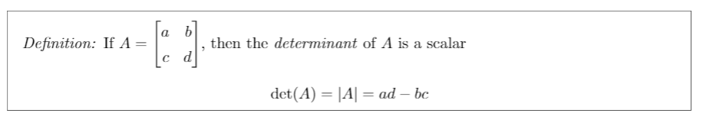
Determinant

Slide 2
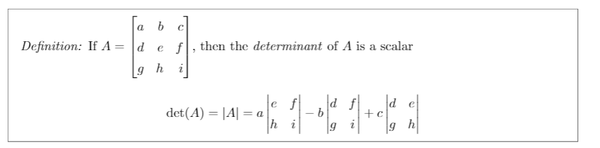
Solving 3x3 Determinant

Slide 3
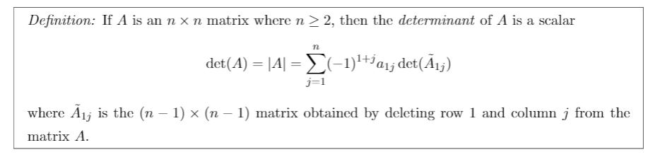
General Determinant

Slide 4
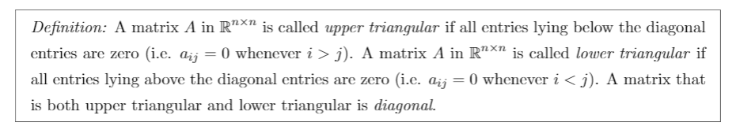
Matrix Types

Slide 5

Characteristic Polynomial

Slide 6
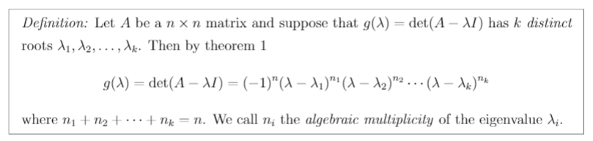
Algebraic Multiplicity

Slide 7

Geometric Multiplicity

Slide 8
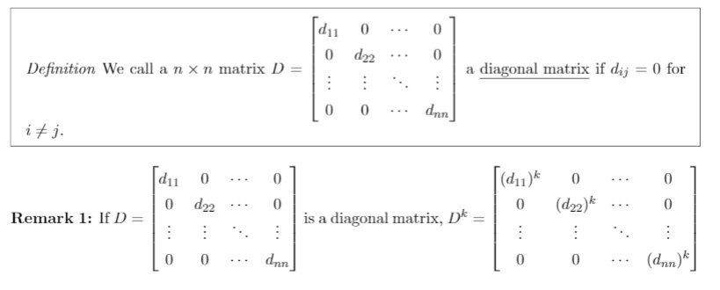
Diagonal Matrix Powers

Slide 9
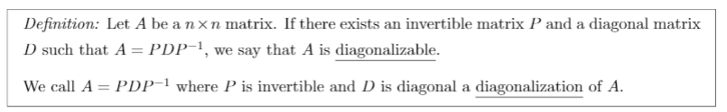
Diagonalizable

Slide 10
Similar Matrix

Slide 11
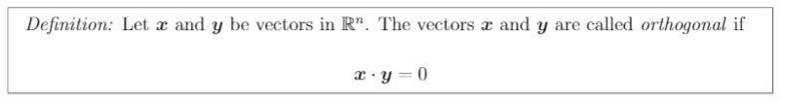
Orthogonal Dot Product

Slide 12
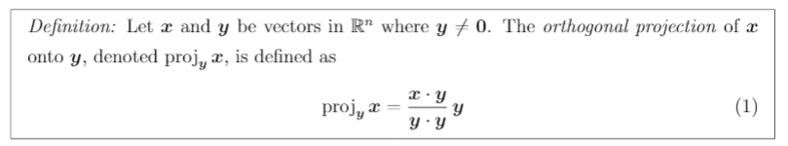
Orthogonal Projection

Slide 13
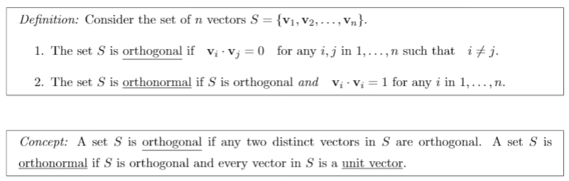
Orthogonal vs. Orthonormal

Slide 14
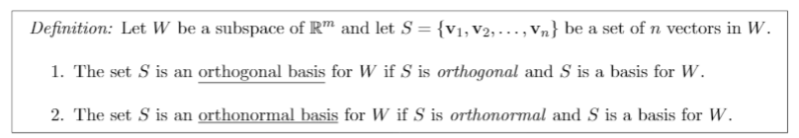
Ortho Basis

Slide 15
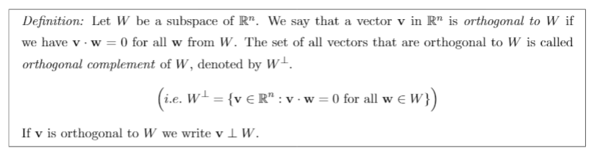
Orthogonal Complement

Slide 16
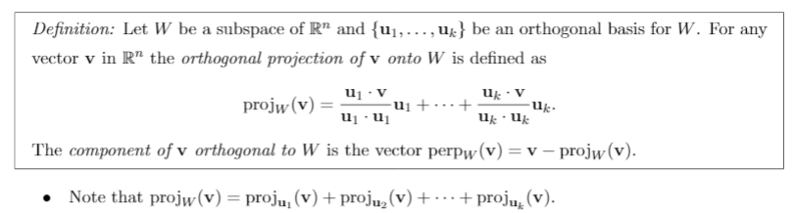
Orthogonal Basis Projection

Slide 17
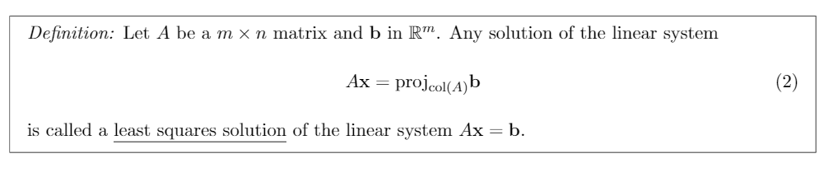
Least Squares Solution

Slide 18
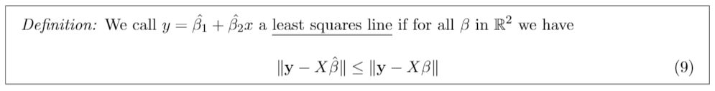
Least Squares Line

Slide 19
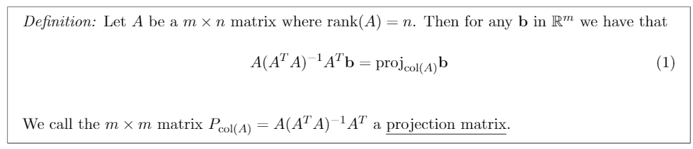
Projection Matrix
Notes:
Optional in Lectures but was on HW 21

